Slide 1
The French Revolution 9th class History

Slide 2
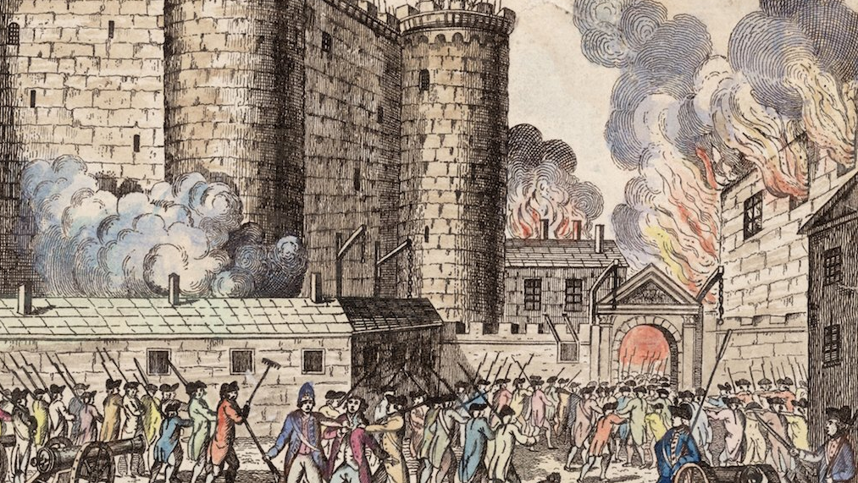
Beginning of French revolution
Storming of the Bastille(14th July 1789)

Slide 3
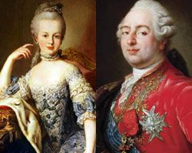
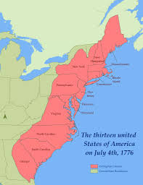
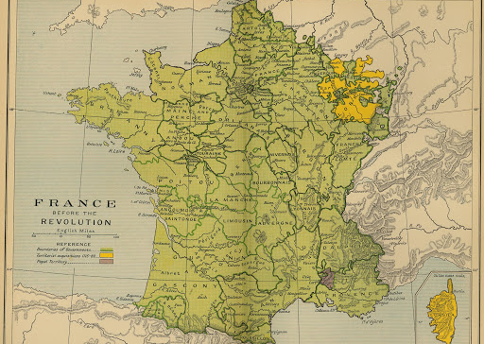
Causes of French Revolution Political Causes
Louis XVI ascended the throne of France.
He found an empty treasury.
Long years of war
cost of maintaining the palace of Versailles
France helped the thirteen American colonies
Lenders charged 10 per cent interest on loans
To meet its regular expenses, for maintaining an army, the court etc, the state was forced to increase taxes.

Slide 4
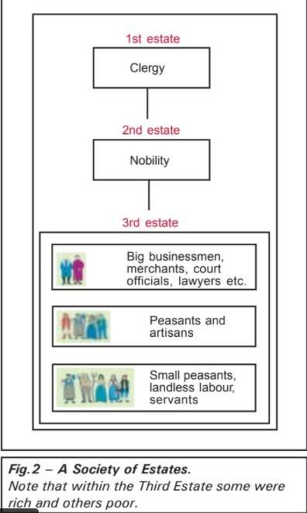
Social causes:
The society was divided into 3 estates:
The members of 1st 2 estates i.e., Clergy and Nobility enjoy certain privileges by birth. They are exempted from paying taxes to the state.
Nobles also enjoy feudal privileges which include feudal dues extracted from peasants.
The church extracts its share of taxes called Tithes from peasants. A direct tax Taille and a no. of indirect taxes are levied on everyday consumption articles like salt and tobacco.

Slide 5
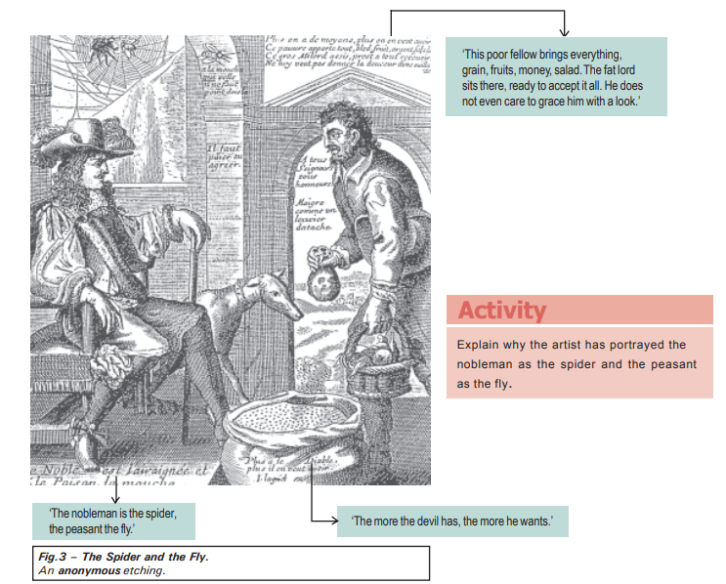

Slide 6
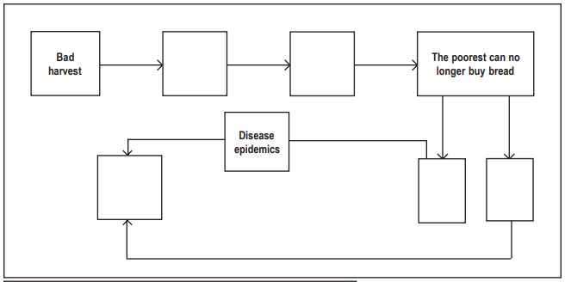
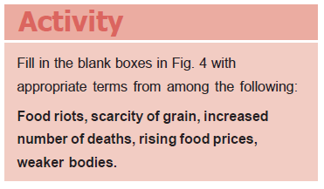
Economic causes(The struggle to survive):
The population of France rose from 23 million to 28
Demand for food grains increased
Production of grains could not keep pace with the demand.
So the price of bread increased.
But wages did not keep pace with
the rise in prices.
This led to a subsistence crisis
An extreme situation where the basic means of livelihood are endangered
The course of a subsistence crisis

Slide 7
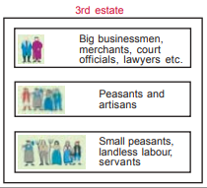
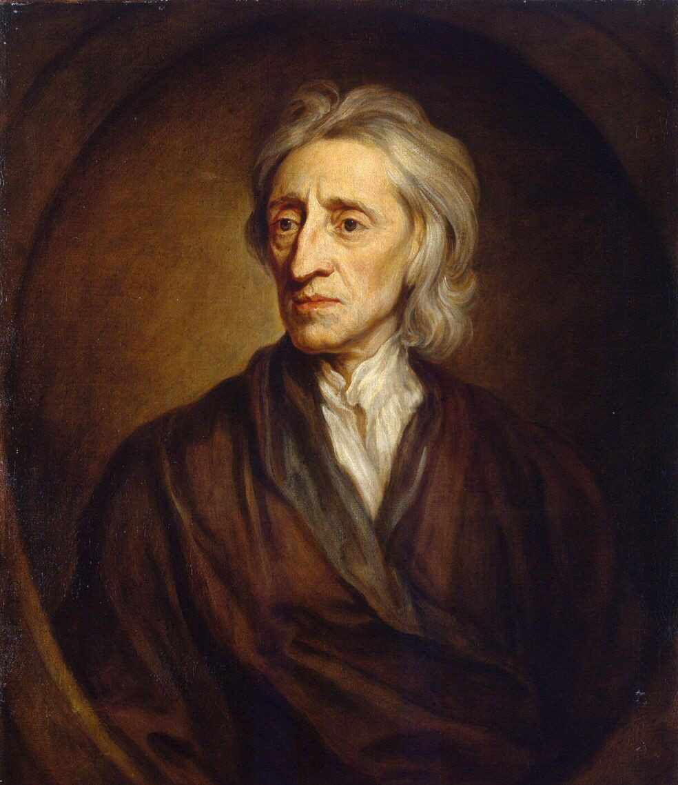
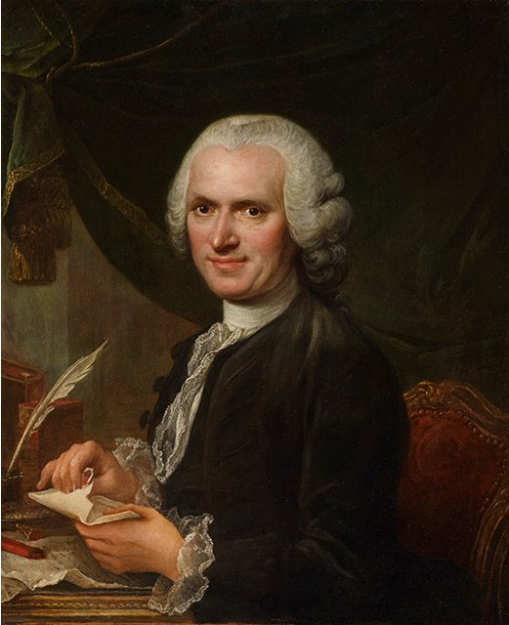
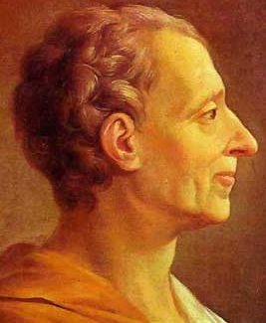
Role of middle class(Envisages an End to Privileges)
Middle class-merchants and Manufacturers, professionals such as lawyers or administrative officials.
They were educated and opposed privileges by birth.
The ideas of these philosophers were discussed intensively in salons and coffee-houses and spread among people through books and newspapers.
John Locke
Rousseau
Montesquieu

Slide 8
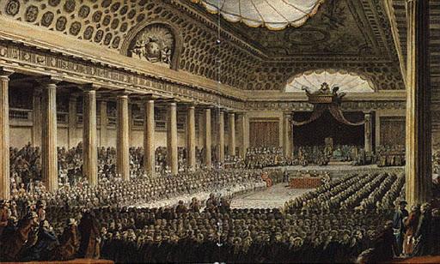
The Outbreak of the Revolution
Louis XVI had to increase taxes.
In the Old Regime the monarch did not have the power to impose taxes he had to call a meeting of the Estates General
The Estates General was a political body to which the three estates sent their representatives
On 5 May 1789, Louis XVI called together an assembly of the Estates General
Estate general meeting in Versailles

Slide 9
The Outbreak of the Revolution
The first and second estates sent 300 representatives each, while the 600 members from the third estate stand at the back.
Voting in the Estates General in the past had been conducted according
to the principle that each estate had one vote.
This was opposed by 3rd estate.
Members of the 3rd estate demanded each member would have one vote

Slide 10
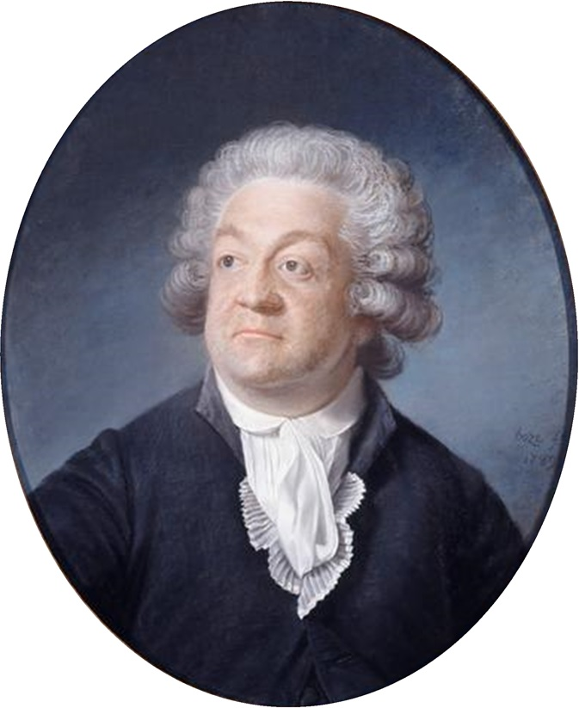
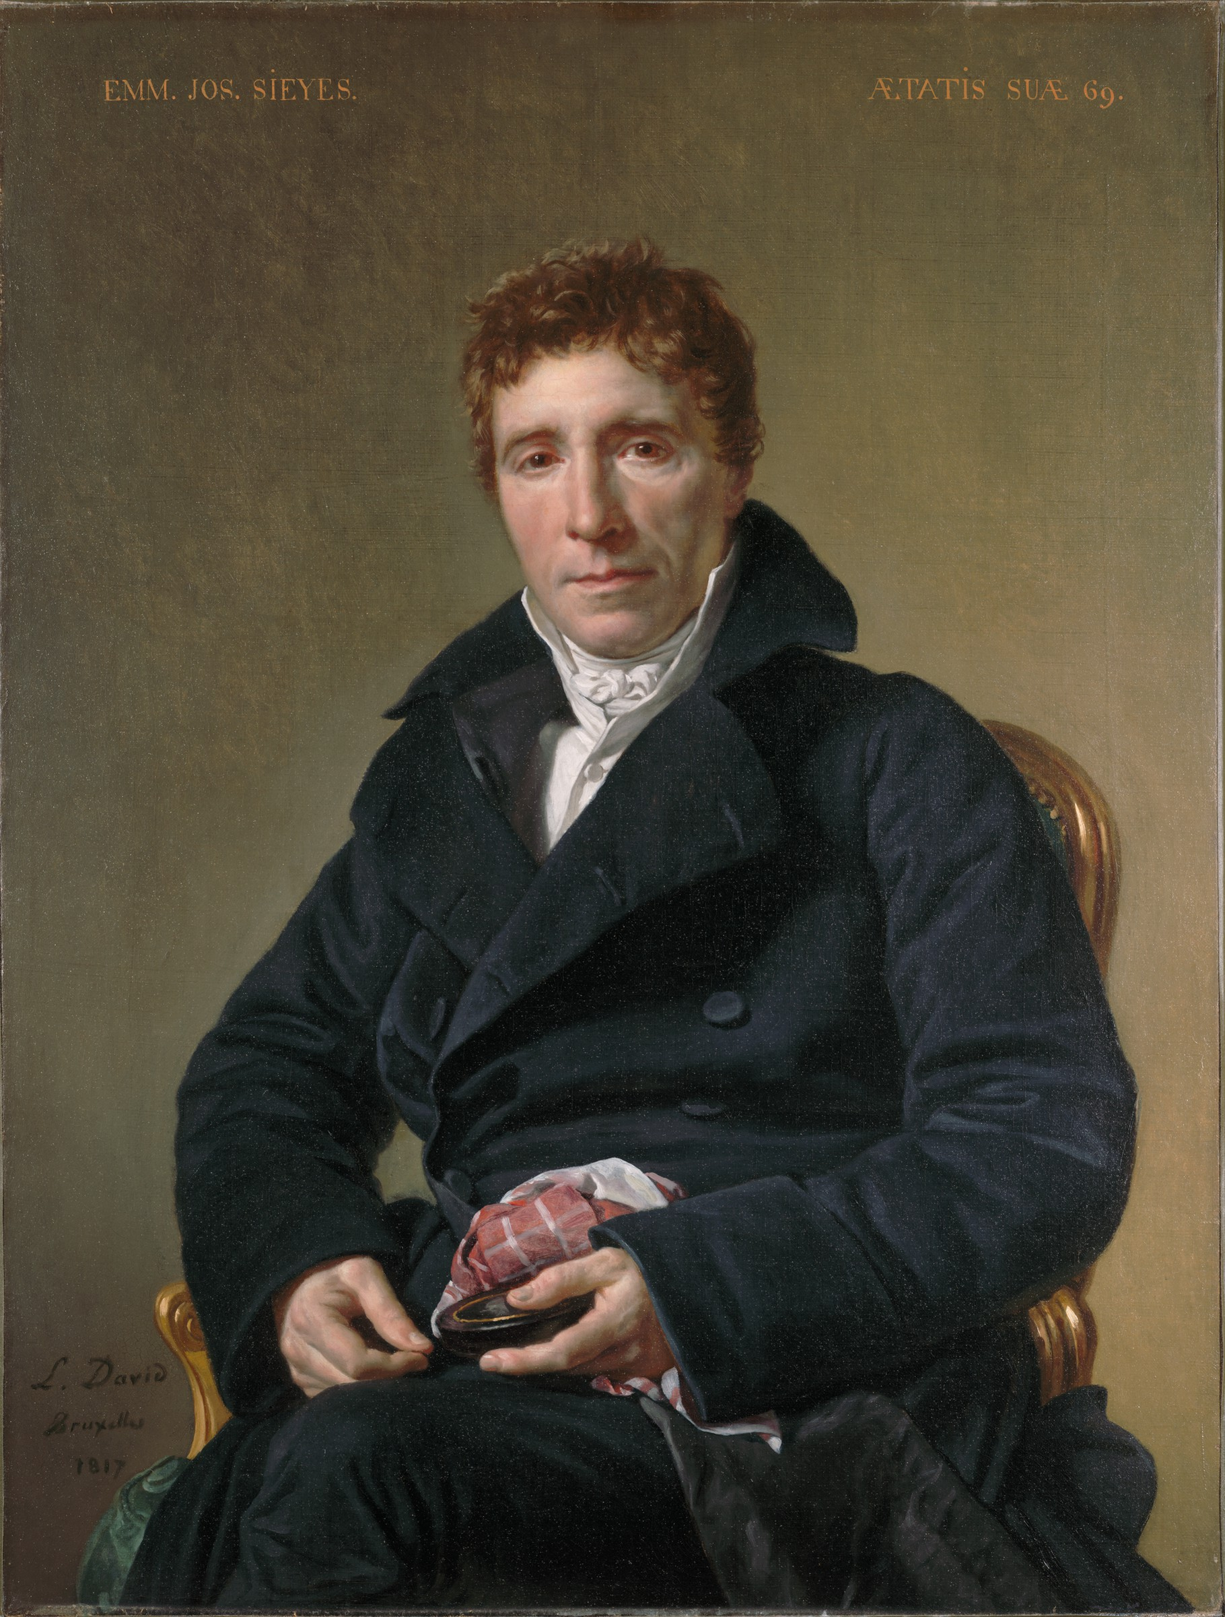
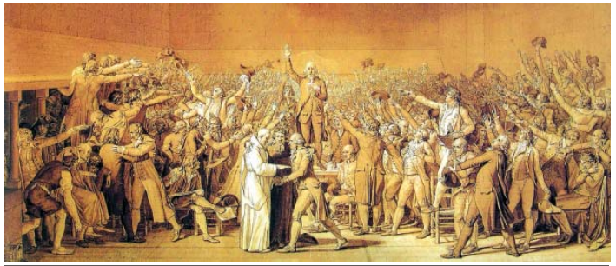
National Assembly
3rd estate declared themselves as national assembly and taken oath not to not to disperse till they had drafted a constitution for France.
National assembly is led by Mirabeau and Abbe Sieyes
Mirabeau
Abbe Sieyes
The Tennis Court Oath.

Slide 11
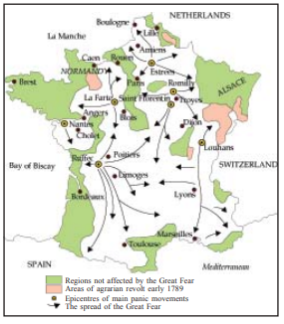
The Spread of the Great Fear
While the National Assembly was busy at Versailles drafting a
constitution, the rest of France seethed with turmoil.
A severe winter
had meant a bad harvest; the price of bread rose, often bakers exploited
the situation and hoarded supplies.
Angry women stormed into the
shops.
On 14 July, the agitated crowd stormed and destroyed the Bastille.

Slide 12
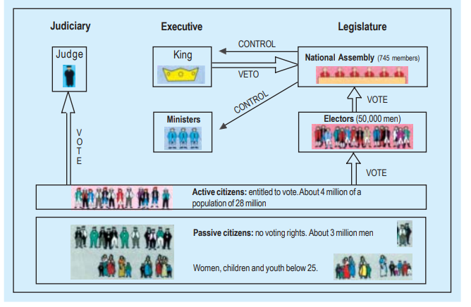
France Becomes a Constitutional Monarchy
Louis XVI accorded recognition to the National Assembly and accepted the principle that his powers would from now on be checked by a constitution.
On the night of 4 August 1789, the Assembly passed a decree abolishing the feudal system of obligations and taxes.
The Political system under the Constitution of 1791

Slide 13
Features of Constitution(1791)
Limit the powers of the monarch
Separation of powers-legislature, executive and judiciary.
Rich Men alone got the right to vote
Indirect election
No rights to passive citizens

Slide 14
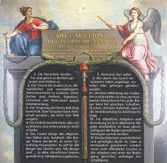
The Declaration of Rights of Man and
Citizen
The Declaration of the Rights of Man and Citizen, painted by the artist Le Barbier in 1790. The figure on the right represents France. The figure on the left symbolises the law.

Slide 16
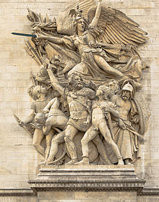
France Abolishes Monarchy and Becomes a Republic
National Assembly voted in April 1792 to declare war against Prussia and Austria.
La Marseillaise

Slide 17
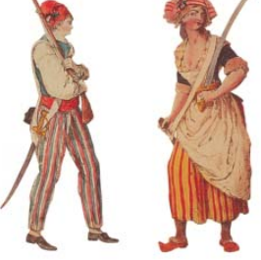
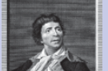
Constitution of 1971 gave political rights only to rich men
Jacobins were the less prosperous sections of society.
They included small shopkeepers, artisans such as shoemakers, pastry cooks, watch-makers, printers, as well as servants and daily-wage workers.
A sans-culottes couple.(Jacobins club)
Jean-Paul Marat

Slide 18
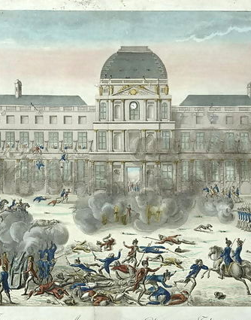
Jacobins Revolt(1792)
Storming the Palace of the Tuileries
Nation Assembly voted to imprison the royal family

Slide 19
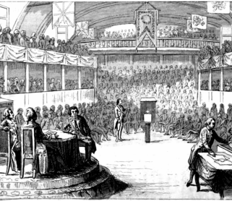
Convention
On 21 September 1792 it abolished the monarchy and declared France a republic.
All men of 21 years and above, regardless of wealth, got the right to vote.

Slide 20
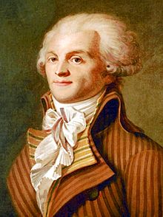
The Reign of Terror
The period from 1793 to 1794 is referred to as the Reign of Terror.
Robespierre followed a policy of severe control and punishment.
Robespierre's government issued laws placing a maximum ceiling on wages and prices.
Meat and bread were rationed.
Equality was also sought to be practised through forms of speech and address.
Guillotine
Maximilien Robespierre

Slide 21
A Directory Rules France
The fall of the Jacobin government allowed the wealthier middle classes to seize power.
New constitution Allowed two elected legislative councils these appointed a Directory, an executive made up of five members.
However, the Directors often clashed with the legislative councils, who then sought to dismiss them.
The political instability of the Directory paved the way for the rise of a military dictator, Napoleon Bonaparte.

Slide 22
Did Women have a Revolution
In the new constitution(1791) women were passive citizens only.
They started political clubs and news papers
The Society of Revolutionary and Republican Women was the most famous of them.
Their main demand was same political rights as men.
They demanded the right to vote, to be elected to the Assembly and to hold political offices.
Revolutionary government did introduce laws that helped improve the lives of women.
Creation of state schools, schooling was made compulsory for all girls.
Their fathers could no longer force them into marriage against their will.
Marriage was made into a contract entered into freely and registered under civil law.
Divorce was made legal.
Women could now train for jobs, could become artists or run small businesses.

Slide 23
The life of a revolutionary woman
Olympe de Gouges(1748-1793)
She protested against the Constitution and the Declaration of Rights of Man and Citizen as they excluded women from basic rights that each human being was entitled to. So, in 1791, she wrote a Declaration of the Rights of Woman and Citizen

Slide 24
The Abolition of Slavery
One of the most revolutionary social reforms of the Jacobin regime was the abolition of slavery in the French colonies.
Triangular slave trade between Europe, Africa and the Americas.
The slave trade began in the seventeenth century. French merchants sailed from the ports of Bordeaux or Nantes to the African coast, where they bought slaves from local chieftains
The exploitation of slave labour made it possible to meet the growing demand in European markets for sugar, coffee, and indigo.
The Abolition of Slavery was finally the Convention which in 1794 legislated to free all slaves in the French overseas possessions.
However Napoleon reintroduced slavery.
Slavery was finally abolished in French colonies in 1848.

Slide 25
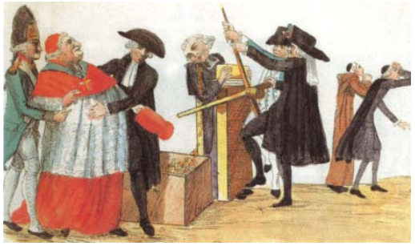
The Revolution and Everyday Life
The revolutionary governments took it upon themselves to pass laws that would translate the ideals of liberty and equality into everyday practice.
One important law that came into effect soon after the storming of the Bastille in the summer of 1789 was the abolition of censorship.
In the Old Regime all written material and cultural activities ñ books, newspapers, plays ñ could be published or performed only after they had been approved by the censors of the king.
Now the Declaration of the Rights of Man and Citizen proclaimed freedom of speech and expression to be a natural right.

Slide 26
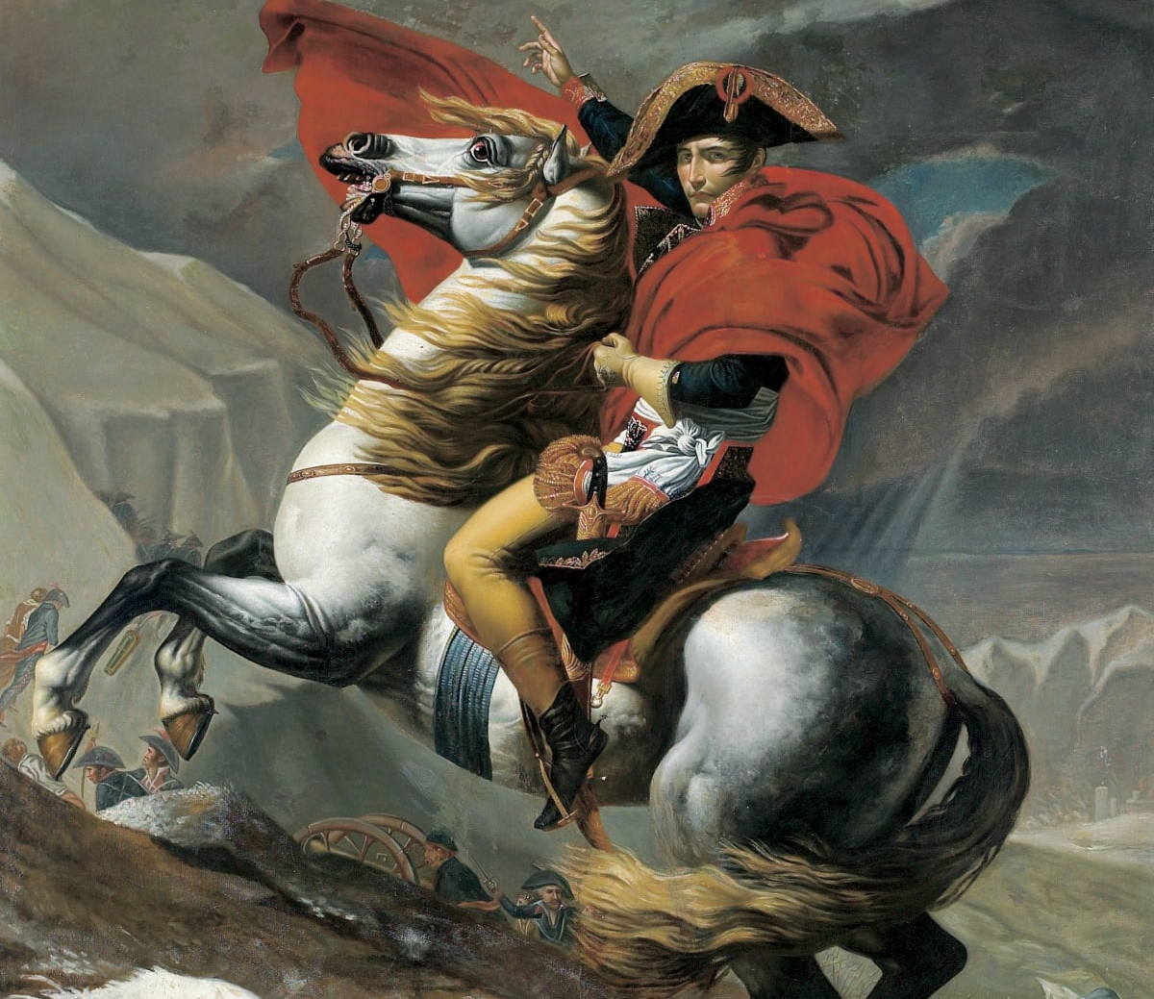
Raise of Napoleon Bonaparte
In 1804, Napoleon Bonaparte crowned himself Emperor of France
He conquered neighbouring European countries.
Napoleon saw his role as a moderniser of Europe.
He introduced many laws such as the protection of private property and a uniform system of weights and measures provided by the decimal system.
He was finally defeated at Waterloo in 1815.
The ideas of liberty and democratic rights were the most important legacy of the French Revolution.
These spread from France to the rest of Europe during the nineteenth century, where feudal systems were abolished. Colonised peoples reworked the idea of freedom from bondage into their movements to create a sovereign nation state. Tipu Sultan and Rammohan Roy are two examples of individuals who responded to the ideas coming from revolutionary France.

Slide 27
Assignment
Describe the circumstances leading to the outbreak of revolutionary protest in France.
Draw up a list of democratic rights we enjoy today whose origins could be traced to the French Revolution.
How would you explain the rise of Napoleon?
On the given outline map of France locate the following places. A)Paris B)Bordeaux C)Marscilles D)Nantes

Slide 28
Thank you

